Slide 1
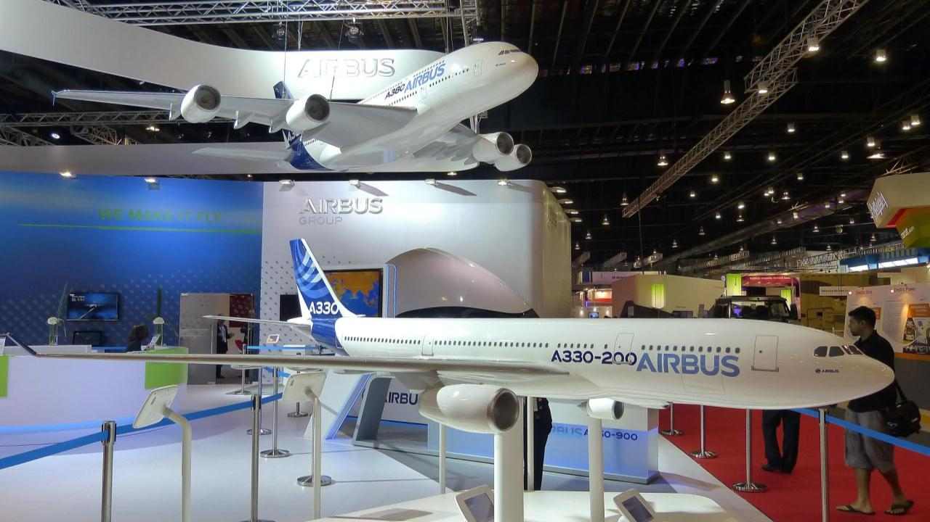
Capstone Project
Airline Passenger Satisfaction
Presented By:
Xiaotong Ma
Liankai Ren
Jie Zhang

Slide 2
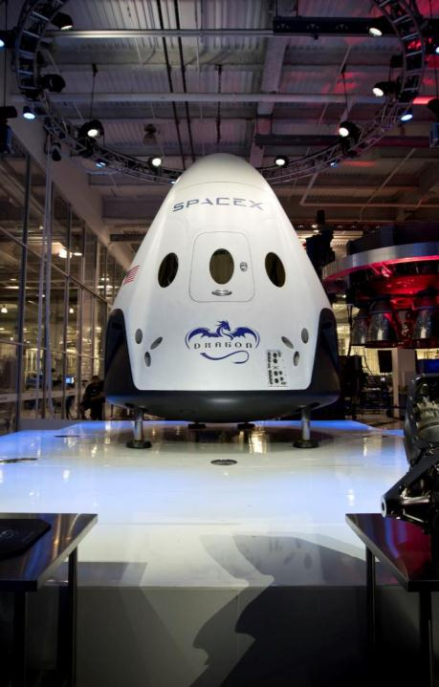
CONTENT
Introduction
Data Preprocessing & EDA
Data Modeling
Summary & Recommendation

Slide 3

INTRODUCTION
PART 1

Slide 4








Overview
Airplanes are one of the first choices for people to travel because of their convenience and safety.
Predicting passenger satisfaction and discovering the main influencing factors can help airlines improve their services and gain advantages in difficult situations and competitions.
In this project, our team will explore the Airline Passenger Satisfaction dataset to forecast passenger satisfaction and provide recommendations for airlines.

Slide 5


Dataset Introduction
Containing records of an airline passenger satisfaction survey (from 1 to 5, and 0 represents not rated).
25976 observations of 25 variables.
Originally, 5 are object variables and 20 are integer variables.

Slide 6
Objectives
1
Determine the most influencing factors of passenger satisfaction.
2
Predict whether a passenger would be satisfied or dissatisfied with the services.
3
Provide recommendations for the airline.

Slide 7
Model Selection
A statistical analysis method to predict a binary outcome.
Logistic regression model predicts a dependent data variable by analyzing the relationship between one or more existing independent variables.
Since the target variable in our project being binary, it can easily fit into the logistic regression model.
Logistic Regression
A supervised learning algorithm used in machine learning. It operated in both classification and regression algorithms.
It splits data into branches like tree branches till it achieves a threshold unit.
Decision tree provides a highly effective structure that can lay out options and investigate the possible outcomes.
Decision Tree

Slide 8
DATA PREPROCESSING & EDA
PART 2

Slide 9

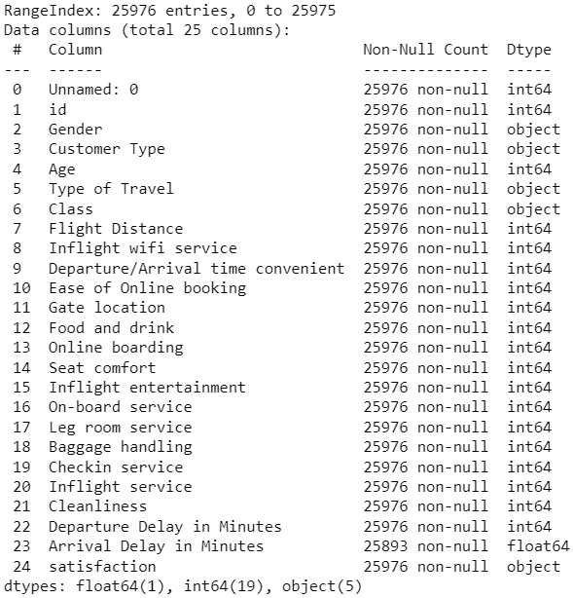

Data Cleansing & Preprocessing
Overview
Data Structure
The dataset contains 25976 observations of 25 variables.
20 numeric variables, and 5 object variables, including the target variable.
Variables
Missing Values
The first 2 columns are unnecessary for our analysis, so we can drop them.
Only one variable contains 83 Null values. Due to large data volume, we can simply remove them.

Slide 10
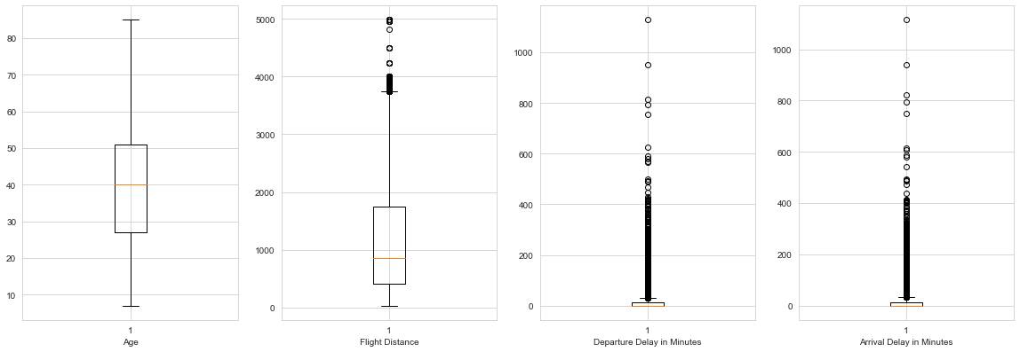
Outliers
Most of the data lies under 500 minutes, but there are still a few data points that have very large values.
The existence of large values is reasonable, and we also would like to know whether it would affect passenger satisfaction or not.
A few outside dots are reasonable and close to the up boundary.
No outlier

Slide 11

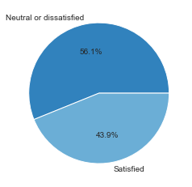



EDA
 | Age | Flight Distance | Departure Delay in Minutes | Arrival Delay in Minutes
count | 25893 | 25893 | 25893 | 25893
mean | 39.621983 | 1193.753254 | 14.225080 | 14.740857
std | 15.134224 | 998.626779 | 37.185919 | 37.517539
min | 7 | 31 | 0 | 0
25% | 27 | 414 | 0 | 0
50% | 40 | 849 | 0 | 0
75% | 51 | 1744 | 12 | 13
max | 85 | 4983 | 1128 | 1115
Target Variable
The number of passengers who were neutral or dissatisfied with their flying journey is 12.2% more than the number of passengers who were satisfied.
Statistical Summary
Age: Median ≈ Mean Assumed normal distribution
Flight Distance: Median < Mean Right skewed
Departure Delay in Minutes: Median < Mean Right skewed
Arrival Delay in Minutes: Median < Mean Right skewed

Slide 12
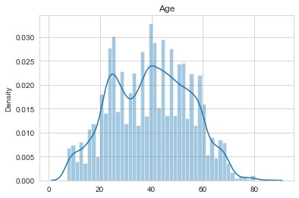
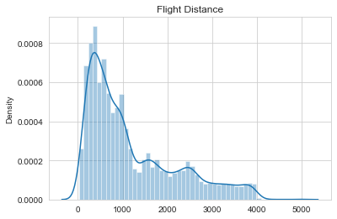
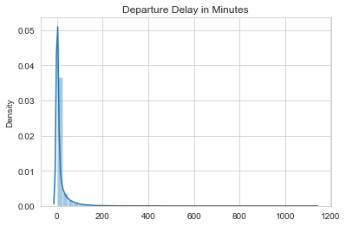
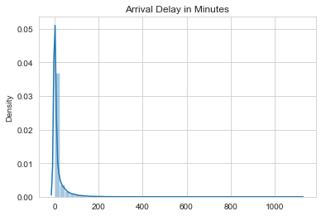
Distribution Plots
Although it is not perfect, most of the data formed a normal distribution.
The data is clearly right (or positive) skewed with a pretty high skewness.
The data is highly right (or positive) skewed with very high skewness.
The data is highly right (or positive) skewed with very high skewness.

Slide 13

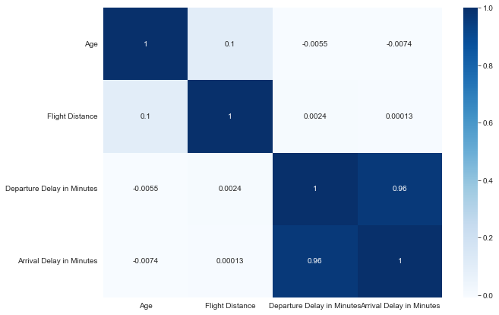
Correlation Map
Most pairwise variables have weak correlations.
There exists a strong positive correlation between the Departure Delay in Minutes variable and the Arrival Delay in Minutes variable as the value of the correlation coefficient reaches 0.96.
The dependence of the arrival time delay on the departure time delay is approximately linear.
Logical explanation: If the flight of the airline was delayed by a certain amount of time at departure, then the flight will be delayed by approximately the same amount of time at landing.

Slide 14
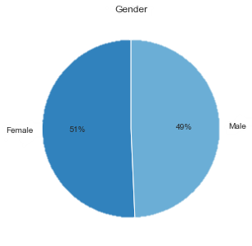
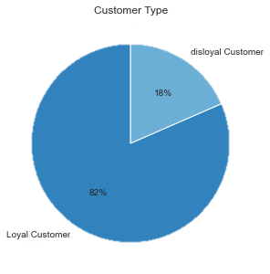
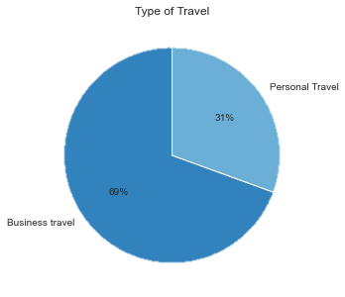
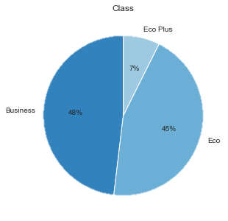
EDA
The number of men and women is approximately the same.
The majority of the passengers are recurring and loyal customers of the airline.
Most of the passengers flew for business rather than personal reasons.
About half of the passengers were in business class.

Slide 15
DATA MODELING
PART 3

Slide 16
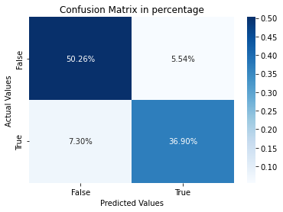
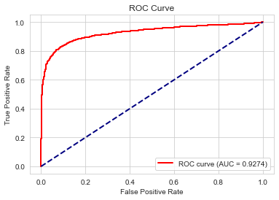
Logistic Regression
Confusion Matrix
ROC Curve
The model accurately predict 36.9% of satisfied passengers and 50.26% of neutral or dissatisfied passengers.
Model Accuracy = 36.9% + 50.26% = 87.16%
The ROC curve is close to the top-left corner, which indicates a good performance of the model.
The AUC of 0.93 also indicates a great model performance.

Slide 17

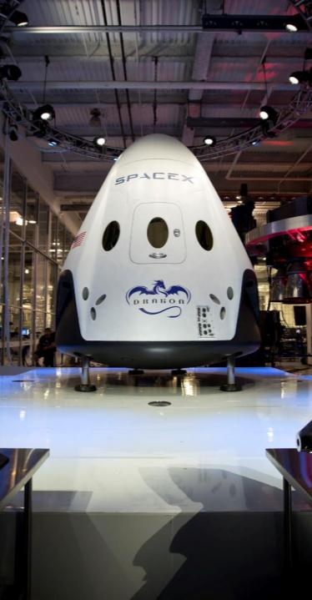
Logistic Regression
The model can correctly predict 87.16% of passenger satisfactions (both satisfied and neutral or dissatisfied).
The model is 86.94% precise on predicting true satisfied passengers out of all satisfied predictions and is 83.49% accurate on predicting true satisfied passengers out of all actual satisfied passengers .
Classification Statistics
Accuracy | Precision | Recall | F-1 Score | AUC
87.16% | 86.94% | 83.49% | 0.85 | 0.9274
The model’s balanced ability to both capture positive cases (recall) and be accurate with the cases it does capture (precision) is 0.85, which is commonly seen as a good value.

Slide 18

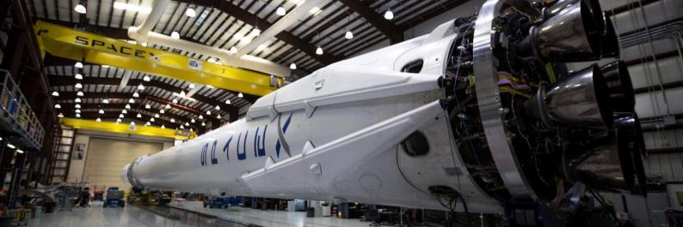


Decision Tree(random state = 42)
Classification Statistics at max depth = 3
Accuracy | Precision | Recall | F-1 Score | AUC
88.78% | 84.63% | 91.18% | 0.88 | 0.925
Accuracy
Precision
The model is 88.78% correct.
When it predicts satisfaction, there are 84.63% of people who are actually satisfied with airline services.
Recall
F-1 Score
When people are actually satisfied with airline services, there are 91.18% to predict people are satisfied.
The weighted average of Precision and Recall is the F1 Score. Therefore, both false positives and false negatives are considered while calculating this score.

Slide 19


Check Model Stability
Test decision tree model accuracy by choosing different random state.
Results of different random state in decision tree model are similar, the model is stable.
Random state = 1
Random state = 101
Random state = 201
Accuracy | 88.43%
Precision | 84.47%
Recall | 91.09%
F1-score | 0.88
Accuracy | 89.01%
Precision | 84.57%
Recall | 91.25%
F1-score | 0.88
Accuracy | 88.13%
Precision | 83.85%
Recall | 90.43%
F1-score | 0.87

Slide 20
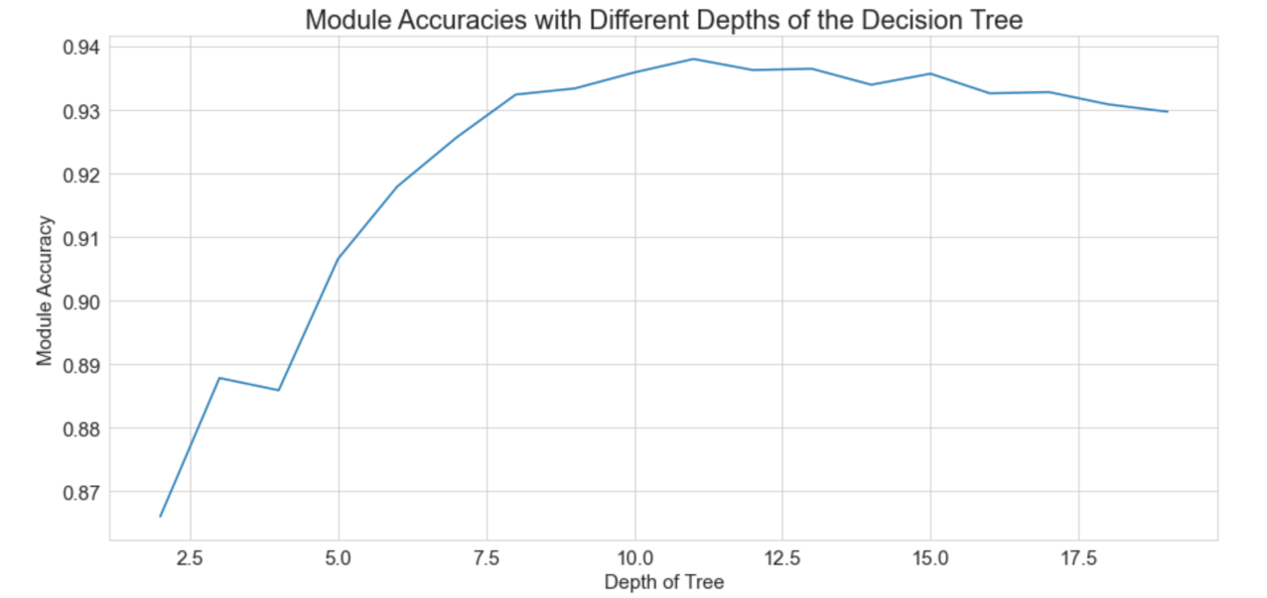
Find the best depth for decision tree model
Max Depth
Using for loop to determine the best tree depth for highest model accuracy from range 2 to 20.
The result shows that the highest accuracy of the decision tree model is with the depth of 11.

Slide 21




Improved Decision Tree Model
Classification Statistics
Accuracy | Precision | Recall | F-1 Score | AUC
93.88% | 94.06% | 92.01% | 0.93 | 0.97
Accuracy has improved
AUC has increased
F1 score has increased
From 88.78% to 93.9%
Accuracy has improved by 5.77%
From 0.925 to 0.97
AUC has improved by 4.89%
From 0.88 to 0.93
F1 score has improved by 5.68%

Slide 22
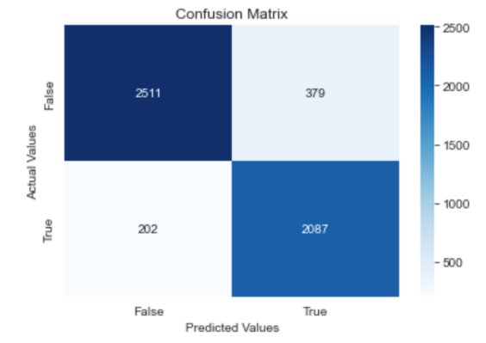
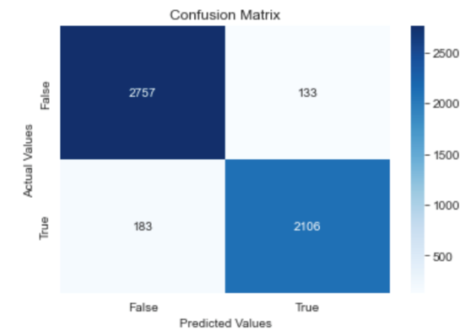
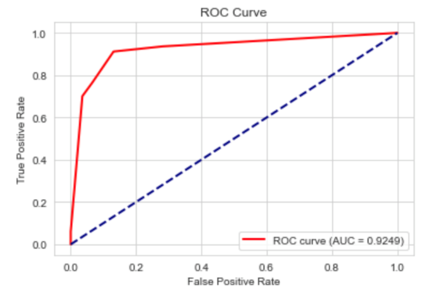
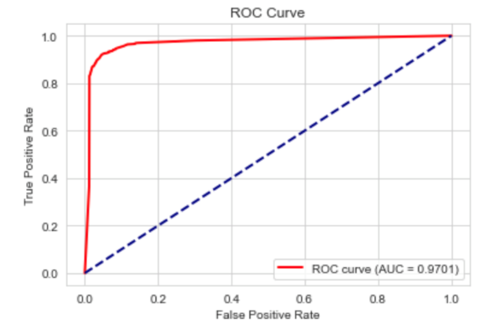
True positive: 2087
True negative:2511
False positive:379
False negative:202
True positive: 2106
True negative:2757
False positive:133
False negative:183
Compare graphs
Model at depth = 3
Model at depth = 11
01
03
02
04
For improved decision tree model, true positives and true negatives are all increased
The closer the ROC curve is to the top-left corner would indicate a better performance.
The improved model performs better

Slide 23

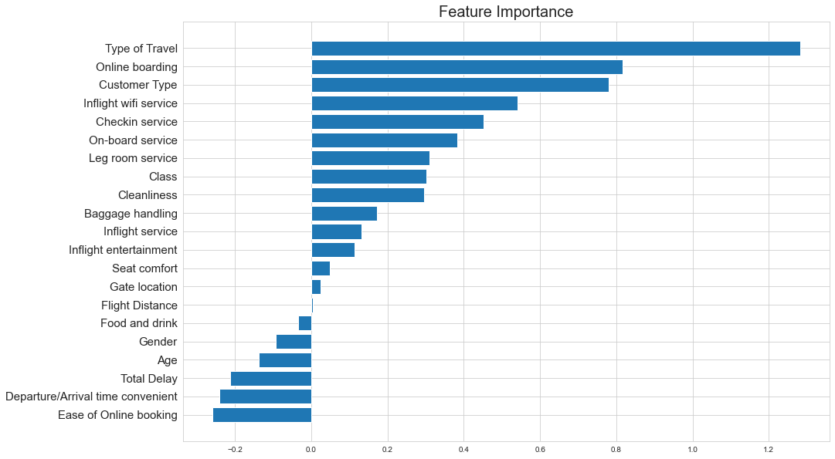






Feature Importance
Contributing features:
14 features have positive influence, 6 features have negative influence, 1 feature has almost none influence

Slide 24
Model Comparison
Logistic Regression Model
Accuracy | Precision | Recall | F-1 Score | AUC
87.16% | 86.94% | 83.49% | 0.85 | 0.9274
Decision Tree Model
Accuracy | Precision | Recall | F-1 Score | AUC
93.88% | 94.06% | 92.01% | 0.93 | 0.97
Conclusion: The decision tree model performs better than the logistic regression model due to higher accuracy score and AUC.

Slide 25
SUMMARY & RECOMMENDATION
PART 4

Slide 26
Summary
The number of male and female customers is approximately the same. The majority of the passengers are loyal customers with business travel.
The average delays per flight on departure and arrival are both lower than the world average in 2022.
The number of unsatisfied passengers is 12.2% more than that of satisfied passengers.
The Logistic Regression model performs better and is selected for the final model in the project.

Slide 27


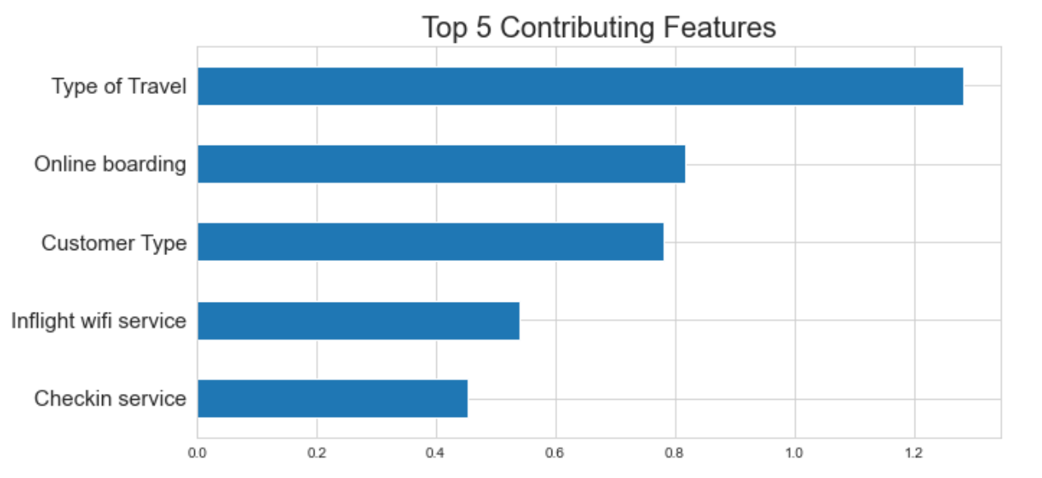
Recommendation
Online boarding, inflight Wi-Fi service and check-in service significantly affect the passengers’ satisfaction.
Develop more friendly services target for the major customer group.
Service Improvement: Create a user-friendly online boarding system and check-in processes including online seat selection and highlighting special needs in advance. Upgrade inflight Wi-Fi hardware.
Target Groups: Free upgrades are offered based on mileage, a little gift during a festival flight and add a Do Not Disturb button for business travel customers.

Slide 28
THANK YOU
Xiaotong Ma
Liankai Ren
Jie Zhang

